Slide 1
SuccessFactors Integration Overview
Copyright © 2018 Accenture. All rights reserved.

Slide 2
What is SuccessFactors
SAP SuccessFactors is a global provider of cloud-based human resource software and fully integrated human capital management (HCM) systems that covers:
Core HR (Employee Central) and Payroll
Time and Attendance Management
Learning and Development
Performance and Compensation
Recruiting and Onboarding
Workforce Planning and Analytics
SuccessFactors has more than 100 million active users in 60 industries for more than 200 countries and services are translated into 42 languages.
SAP SuccessFactors offers solutions in both as standalone solution as well as Hybrid solution where SuccessFactors can be integrated with On-Premise SAP HCM Solution
Copyright © 2018 Accenture. All rights reserved.

Slide 3















SuccessFactors History
SuccessFactors Inc.
2001
Went Public with Symbol
SFSF
2007
2011
Lars Dalgaard
Transfer of Listing
SAP acquire SuccessFactors
First triple listed technology company
2012
Accenture offers HR Audit and Compliance Tool
2013
SFSF Platform Opened-up as part of SAP Cloud Platform
A software that can automatically check data against specified criteria and rules
Copyright © 2018 Accenture. All rights reserved.
Notes:
SuccessFactors was founded by Lars Dalgaard(Denmark) in 2001
“https://signal.nfx.com/investors/lars-dalgaard”
In 2007
SuccessFactors went public on the Nasdaq Global Market(Stock) under the stock symbol SFSF
NASDAQ - National Association of Securities Dealers Automated Quotations
https://www.nasdaq.com/markets/ipos/company/successfactors-inc-751622-55446
In Mid 2011
SuccessFactors, Inc. (NASDAQ: SFSF) announced that it is transferring the listing of its common stock to the New York Stock Exchange ("NYSE"), NYSE Euronext and BORSE Frankfurt.
http://logok.org/nyse-logo/
http://www.hitc.com/en-gb/2013/08/21/nyse-said-to-choose-jpmorgan-socgen-for-euronext-ipo/
https://deltafonts.com/frankfurt-stock-exchange-font/
In Dec 2011
SAP entered into a definite merger agreement with SuccessFactors. The acquisition will add SuccessFactors' widely respected team and technology to SAP's powerful cloud assets, significantly accelerating SAP's momentum as a provider of cloud applications, platforms and infrastructure. The combination of SAP and SuccessFactorswill establish an advanced end-to-end offering of cloud and on-premise solutions for managing all relevant business processes.
http://phx.corporate-ir.net/phoenix.zhtml?c=214238&p=irol-newsArticle&ID=1635820
In 2012
SAP and SuccessFactors announced that SAP has completed the acquisition of SuccessFactors. SAP purchase SF by 3.4 Billion Dollar
http://phx.corporate-ir.net/phoenix.zhtml?c=214238&p=irol-newsArticle&ID=1664639

Slide 4
SuccessFactors Cloud Solution SaaS Model
Software as a Service (SaaS), is a shared system of software and resources used by multiple companies.
It is based on Cloud computing technology where multiple vendors use the same software and servers for the executions of their tasks and processes.
Software and customer data, is hosted remotely and access on demand from any location using their login credentials of organization(company)
SuccessFactors instance (server) are located in different places or data centers.
Advantages of SaaS Model:
Access from anywhere
No hardware or maintenance required
Regular releases, bugs fixes, updates, and enhancements
Subscription-based licensing model
Multi-tenant Platform
Copyright © 2018 Accenture. All rights reserved.

Slide 5



What is Employee Central (EC)
Employee Central is an HCM System that enable to collect and manage Personal Information and Employment Information.
Employee Central consist of:
Employee Objects
Comprises Personal and Employment details for employees
Foundation Objects
Comprises organization, pay and job structure details
Metadata Framework (MDF) Objects
When the standard delivered foundation objects do not meet requirements, existing foundation objects are migrated to the MDF framework (becoming generic objects in the process).
Copyright © 2018 Accenture. All rights reserved.

Slide 6





What is Entity
EC stores data in table structures which are known as Entities.
EC Entities let you create, manipulate employee data, and navigate from entity associated between entities.
Each entity has the following properties:
Business keys: Uniquely identifies record
Effective dating: Allows you to make schedule changes to a record
Required/nullable attribute: Allows you to identify fields that are required or optional and can be set as null
Copyright © 2018 Accenture. All rights reserved.

Slide 7
Properties of Entities
Business Key
a set of fields that uniquely identity a record for an entity. Each entity, at minimum, uses the following fields to make up a business key:
an individual entity can have additional fields that make up its business key
fields that make up business keys are required fields and cannot be marked as nullable for all entities.
Entity Type | Business Keys
Person Entity | person id external effective start date
Employment Entity | user id effective start date sequence number
Foundation Entity | external code effective start date
Copyright © 2018 Accenture. All rights reserved.

Slide 8

Properties of Entities
Effective Dating
Most of the entities in HCM includes effective start date field. The value may be past, present or future date for which the record may take effect.
Entities also do have createdOn, createdDateTime, lastModifiedOn and lastModifiedDateTime fields which contains the date upon which the event occurs or was recorded.
The fields lastModifiedOn and lastModifiedDateTime store the date and time of the last change or creation in two different formats:
lastModifiedDateTime with type Edm.DateTimeOffset have timezone information (UTC)
lastModifiedOn with type Edm.DateTime represent the date information in the timezone of the server
Recommendation: Always use the UTC time zone to avoid inconsistency
Copyright © 2018 Accenture. All rights reserved.

Slide 9
Properties of Entities
Required/Nullable Attribute
Required field attribute is determine by the data model. For business key, it is always set to true.
By default, nullable attribute is set to false(Nullable="false“) for business key, and all other have this properties set to true.
Copyright © 2018 Accenture. All rights reserved.
Notes:
Describe the required fields and attributes

Slide 10
Employee Central Entities
Employee Entities
Describe Person and Employment Objects
Person Objects – Examples: PerPerson, PerPersonal, PerEmail
Employment Objects – Examples: EmpJob, EmpEmployment, EmpCompensation
Foundation Entities
Describes other general data such as organization, job code and pay component.
Examples: FODepartment, FODivision, FOBusinessUnit
MDF Entities
Describe the customize objects from which standard delivered foundation objects do not meet requirements.
Examples: Position
Copyright © 2018 Accenture. All rights reserved.
Notes:
Samples Entities for Employee Central per Objects

Slide 11
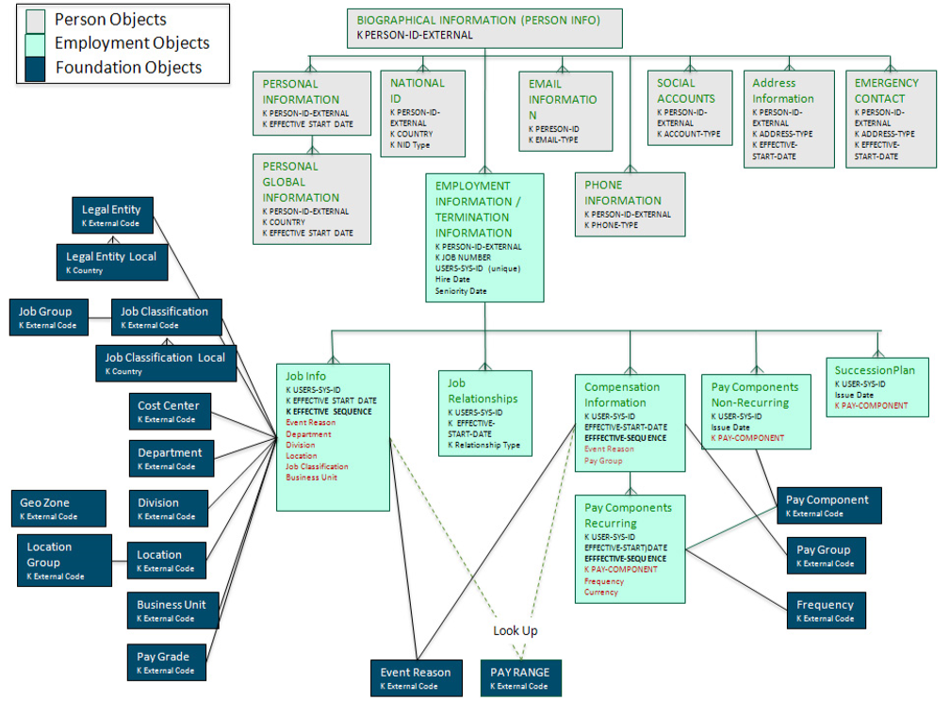
Employee Central Entity Relationship Diagram
Copyright © 2018 Accenture. All rights reserved.
Notes:
Defines the Relationship Diagram within SuccessFactors

Slide 12
Employee Central – Person Entities
<Biographical Information>
PerPerson
personIdExternal
<Personal Information>
PerPersonal
<National ID>
PerNationalId
<Email Information>
PerEmail
<Phone Information>
PerPhone
<Address Information>
PerAddressDEFLT
personIdExternal
startDate
personIdExternal
cardType
country
personIdExternal
emailType
personIdExternal
phoneType
personIdExternal
startDate
addressType
<Personal Global Information>
PerGlobalInfo
<Emergency Contact>
PerEmergencyContacts
personIdExternal
startDate
country
personIdExternal
name
relationship
Copyright © 2018 Accenture. All rights reserved.
Notes:
Define the commonly use SuccessFactors Person Objects:
<Portlet Name>
Entities
-----------------------
Business keys
-----------------------

Slide 13
Employee Central – Employment Entities
<Employment Information>
EmpEmployment
personIdExternal
userId
<Compensation Information>
EmpCompensation
<Job Relationships>
EmpJobRelationships
<Job Information>
EmpJob
<Work Permit>
EmpWorkPermit
<Pay Components Non-Recurring>
PerAddressDEFLT
userId
startDate
seqNumber
userId
startDate
relationshipType
userId
startDate
seqNumber
userId
documentType
documentNumber
Country
userId
payDate
payComponentCode
<Pay Components Recurring>
EmpPayCompRecurring
userId
startDate
seqNumber
payComponent
Copyright © 2018 Accenture. All rights reserved.
Notes:
Define the commonly use SuccessFactors Employment Objects:
<Portlet Name>
Entities
-----------------------
Business keys
-----------------------

Slide 14
Employee Central – Foundation Entities
<Job Information>
EmpJob
userId
startDate
seqNumber
<Legal Entity>
FOCompany
<Cost Center>
FOCostCenter
<Division>
FODivision
<Business Unit>
FOBusinessUnit
<Department>
FODepartment
externalCode
startDate
externalCode
startDate
externalCode
startDate
externalCode
startDate
externalCode
startDate
<Job Classification>
FOJobCode
<Location>
FOLocation
<Pay Grade>
FOPayGrade
<Event Reason>
FOEventReason
externalCode
startDate
externalCode
startDate
externalCode
startDate
externalCode
startDate
<Job Classification Local>
FOJobClass<country>
country
externalCode
startDate
Copyright © 2018 Accenture. All rights reserved.
Notes:
Define the commonly use SuccessFactors Foundation Objects:
<Portlet Name>
Entities
-----------------------
Business keys
-----------------------

Slide 15


SuccessFactors Integration API’s
ODATA API
A REST(Representational State Transfer) services that expose SuccessFactors EC Entities.
Relies on a simple URL(HTTP) approach that you can obtain to Get, Put, Delete, Upsert/Post data in SuccessFactors from the Entities
Output data support format such as CSV,JSON,XML,etc…
Odata API Service URL “https://<EndpointURL>/odata/v2”
SFAPI (SuccessFactors API)
A SOAP(Simple Object Access Protocol) Web Service designed for importing and exporting data to and from your SuccessFactors instance
It provides generic CRUD (Create, Read, Update, Delete) operations to access data in SuccessFactors tables called Entities or SFObjects
Relies exclusively on XML to provide messaging services
SFAPI Service URL “https://<EndpointURL>/sfapi/v1/soap”
Copyright © 2018 Accenture. All rights reserved.
Notes:
Define the Integrations API’s supported by SuccessFactors

Slide 16
SuccessFactors Sample EndPoint URL
DataCenter Information | Environment | Endpoint URL
Amsterdam2/HCM(DC2) | Production | https://api2.successfactors.eu
Amsterdam2/HCM(DC2) | SalesDemo | https://apisalesdemo2.successfactors.eu
Amsterdam2/HCM(DC2) | Preview | https://api2preview.sapsf.eu
Ashburn1/HCM (DC8) | Production | https://api8.successfactors.com
Ashburn1/HCM (DC8) | SalesDemo | https://apisalesdemo8.successfactors.com
Ashburn1/HCM (DC8) | Preview | https://api8preview.sapsf.com
Chandler1/HCM (DC4) | Production | https://api4.successfactors.com
Chandler1/HCM (DC4) | SalesDemo | https://apisalesdemo4.successfactors.com
Chandler1/HCM (DC4) | Preview | https://api4preview.sapsf.com
Your API endpoint will depend on where your SuccessFactors instance is located.
It can be in one of several data centers.
Contact your SuccessFactors representative if you are unsure of which data center to use.
Copyright © 2018 Accenture. All rights reserved.
Notes:
Sample End Point URL for the SuccessFactors Instances(environment)

Slide 17

When can we use OData API?
You want to use the Role Based Permission (RBP) concept
You want concurrent user access with an extension platform to build your own UI’s on top of Employee Central
You want to access MDF data
You want to replicate data in Admin Mode for read and write operations
You want to handle batch processing method
Don't use our OData APIs when:
Your system cannot consume either OData APIs or SOAP for an initial data load
You need employee replication field level delta, snapshot, or read modified employees only.
You only need to read employee data.
Copyright © 2018 Accenture. All rights reserved.
Notes:
Do’s and Don’t for Odata API

Slide 18
When can we use SFAPI?
You want to extract employee data for replication into other system, then SOAP Compound API is the tool of choice.
You had application that wanted only to retrieve information in SuccessFactors
Don't use our SFAPI when:
You want to access custom object or MDF object
You want to retrieve record into certain level(expand)
You had requirements that process large amount of data
Usage in HCP or UI consumption for write/update data
Copyright © 2018 Accenture. All rights reserved.
Notes:
Do’s and Don’t for Successfactors API(SFAPI)

Slide 19

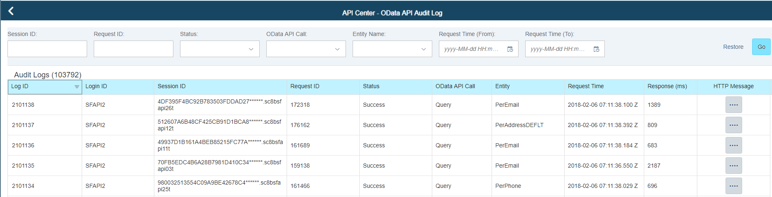
SuccessFactors Integration Tools – Odata API
OData API Audit Log
Help with support and debugging issues related to OData usage
Odata Audit Log Integration tool monitors traffic, gets detailed payload information about API requests made to your system.
The log lets you inspect the exact OData payload requests made to the system and corresponding OData responses sent by the system.
The OData Audit log captures payload details for the last 10,000 OData calls
Copyright © 2018 Accenture. All rights reserved.
Notes:
This log lets you inspect the exact OData payload requests made to the system and corresponding OData responses sent by the system.
The tool is for developers who use OData during an implementation, or administrators who want to share information in this log with SuccessFactors HCM Suite Support to help resolve OData related issues.
You can download data from individual calls, and send it to a Support representative for analysis.

Slide 20
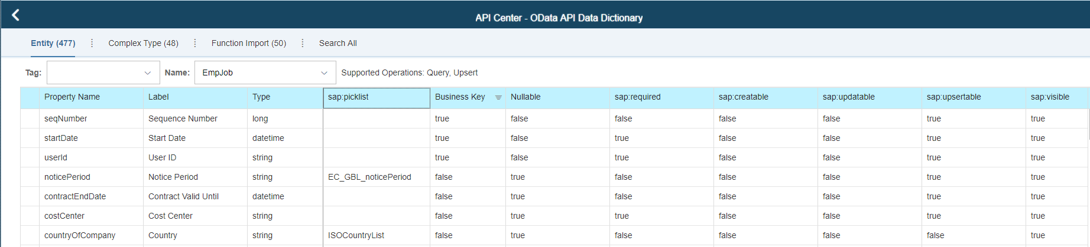
SuccessFactors Integration Tools – Odata API
OData API Data Dictionary
Help developer and functional to view the available Entities and Functions
You can determine the supported operations, property name, business keys, available picklist, etc…
Copyright © 2018 Accenture. All rights reserved.
Notes:
Odata API Dictionary let you view the configured properties in SuccessFactors

Slide 21
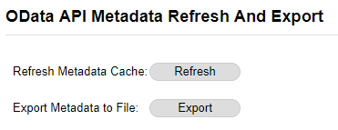
SuccessFactors Integration Tools – Odata API
OData API Metadata Refresh and Export
Help developer to Export the Data Model/Metadata in SuccessFactors
Help developer and functional to Refresh the Metadata Cache
Metadata Refresh often trigger (manually or job) when configuration was change in SuccessFactors
Copyright © 2018 Accenture. All rights reserved.
Notes:
Odata Metadata Refresh and Export
Metadata Refresh will update the structure or properties of the entities in the system.
Best Practice – run this tool after configuration changes.
Sample: When a new MDF object was created, you need to refresh the metadata in SuccessFactors system of you to use the new Entity(table)

Slide 22
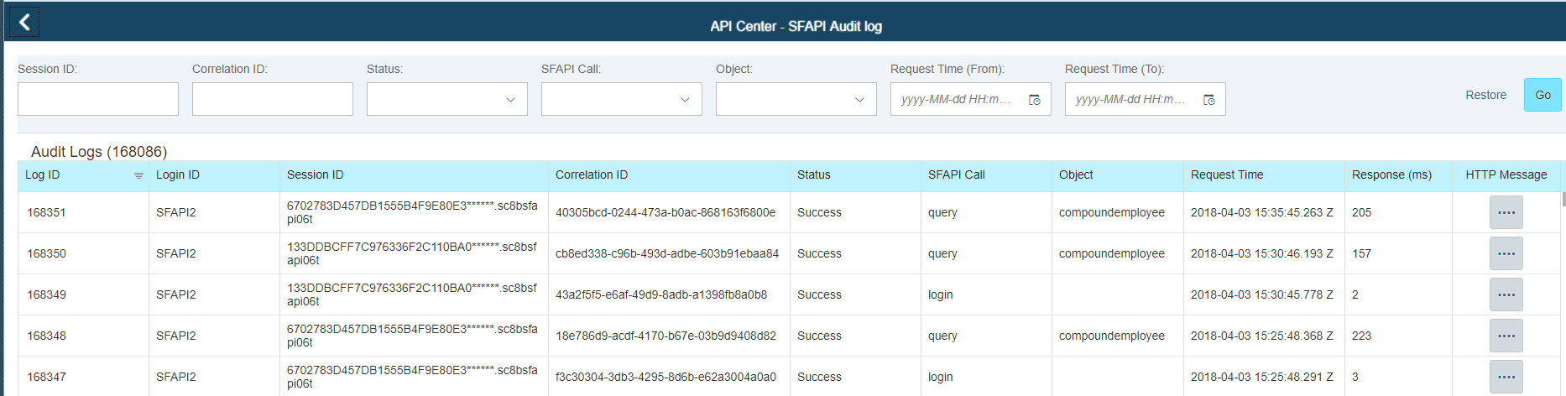
SuccessFactors Integration Tools – SFAPI
SFAPI Audit Log
Help with support and debugging issues related to SFAPI usage
SFAPI Audit Log Integration tool monitors traffic, gets detailed payload information about API requests made to your system.
The log lets you inspect the exact API payload requests made to the system and corresponding API responses sent by the system.
The API Audit log captures payload details for the last 10,000 API calls
Copyright © 2018 Accenture. All rights reserved.
Notes:
The API Audit log captures payload details for the last 10,000 API calls. This log allows you to inspect exactly the API payload request made to the system and the corresponding API response sent by the system. The API Audit Log is intended to help with support and debugging of API usage. The intended end user will be a developer who is using the API during an implementation or an administrator who can share information in this log with SuccessFactors support to help resolve API related support issues. The tool allows you to download data from individual calls, which you could then send to a SuccessFactors support representative.

Slide 23
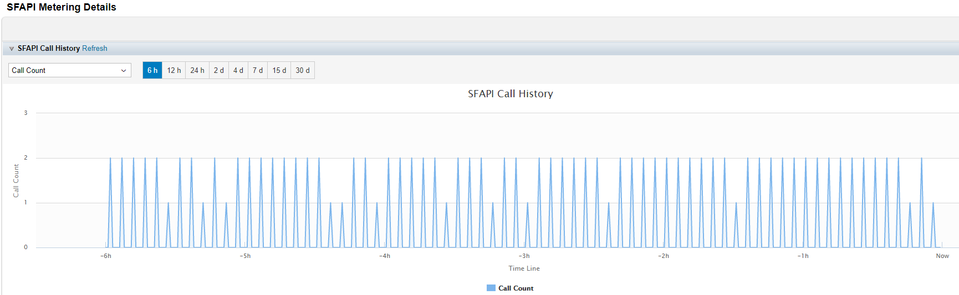
SuccessFactors Integration Tools – SFAPI
SFAPI Metering Details
Give you analytics on your API usage for the last 30 days.
You can see SFAPI call history analytics like how many times the SFAPI was called, or what was the total record counts accessed in your system.
Copyright © 2018 Accenture. All rights reserved.

Slide 24
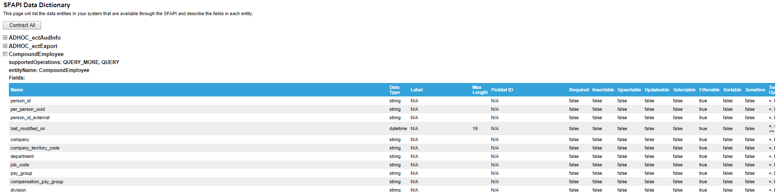
SuccessFactors Integration Tools – SFAPI
SFAPI Data Dictionary
Give you access to the list of all data entities in your SF instance
You can determine the supported operations, entity name, fields, available picklist, etc…
Copyright © 2018 Accenture. All rights reserved.

Slide 25
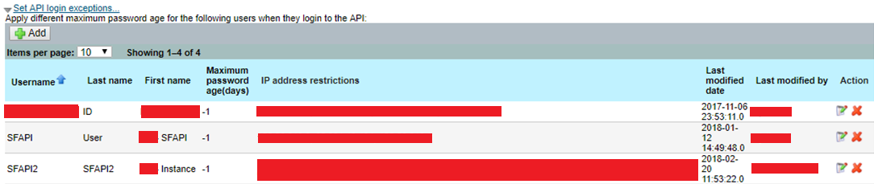
SuccessFactors Integration Tools
OData IP and SFAPI IP Whitelisting
Help control the security access of the third party application id by specifying the IP address from which the API is accessible
Copyright © 2018 Accenture. All rights reserved.
Notes:
Limit the access of the username to specific IP address for security purpose.
Business Case:
Project that use generic username to connect in SuccessFactors are prone to risk. Most of the ID’s shared during implementation or support do have Admin Access.
Since we are in the cloud solution, any one can access the system and can edit the record. It would be difficult to trace the specific person that made some changes in the system if we share the generic username.
IP whitelisting serves as a firewall protection and avoid hacking some data in your system.

Slide 26
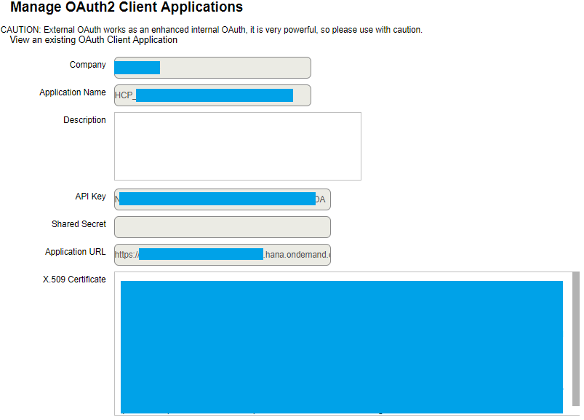
SuccessFactors Integration Tools
Manage OAuth2 Client Applications
Enable your Inbound application connect directly to SuccessFactors
Commonly use for integration like HCI, UI5, Boomi, .Net
Copyright © 2018 Accenture. All rights reserved.

Slide 27
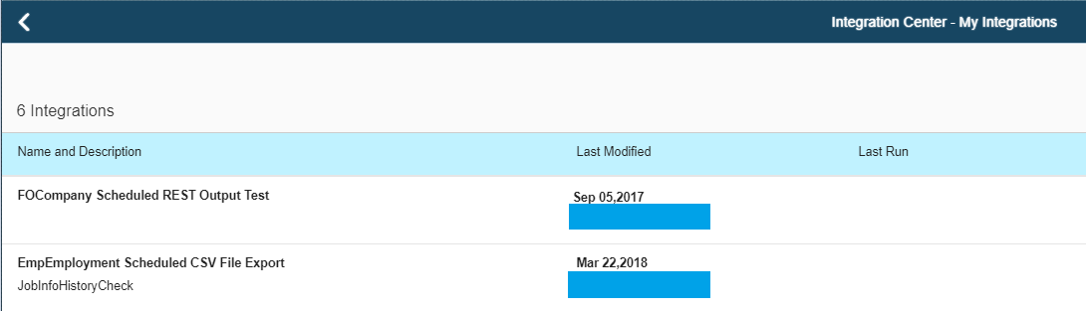
SuccessFactors Integration Tools
Integration Center
Enables HR business analysts to build, run, schedule and monitor simple outbound integrations
Outbound Integration support sending
data using:
Secured File Transfer
SOAP Services
REST Services
Format Supported:
CSV
XML
Odata v2
JSON
Copyright © 2018 Accenture. All rights reserved.
Notes:
Integration Center should be the first tool to consider when building an outbound integration from SAP SuccessFactors.
It can access all the data available to the OData APIs.
You can do filters, sorting, joins, field mappings, transformation, and can output the data in multiple formats.
Integration Center also has scheduling capabilities and supports data encryption.
It is accessible to the client via the admin center, it’s a good choice for less complex integrations.
Limitations:
- not able to perform complex logics or filters
- not able to join multiple entities that are not bound/associated
Use SAP Cloud Platform (HCI) or Dell Boomi for more complex outbound integration

Slide 28

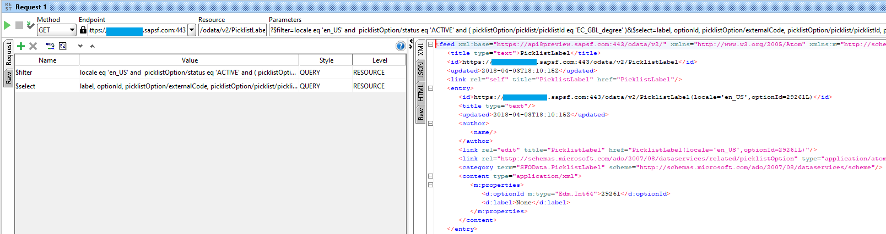
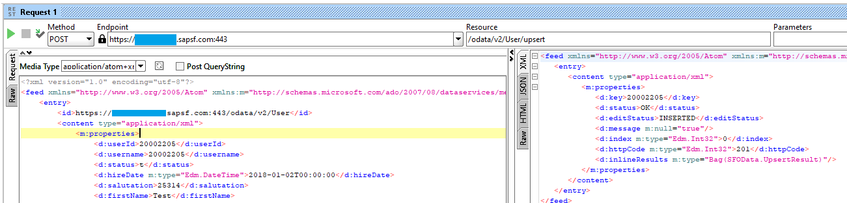
Developer Integration Tools
SOAP UI
An open-source web service testing application for SOAP and REST API.
Enables developer and functional to perform web service inspection, mock development and simulation, functional testing, load and compliance testing.
Copyright © 2018 Accenture. All rights reserved.
Notes:
SOAP UI tool support both SOAP and REST services.
Benefits developer, tester and functional to perform simulations for Odata API, manipulate string when updating record in SF.
Very useful during analysis and design phase for functional.
You may also use this tool to investigate or simulate the payload that you are planning to develop in your integration tool.

Slide 29
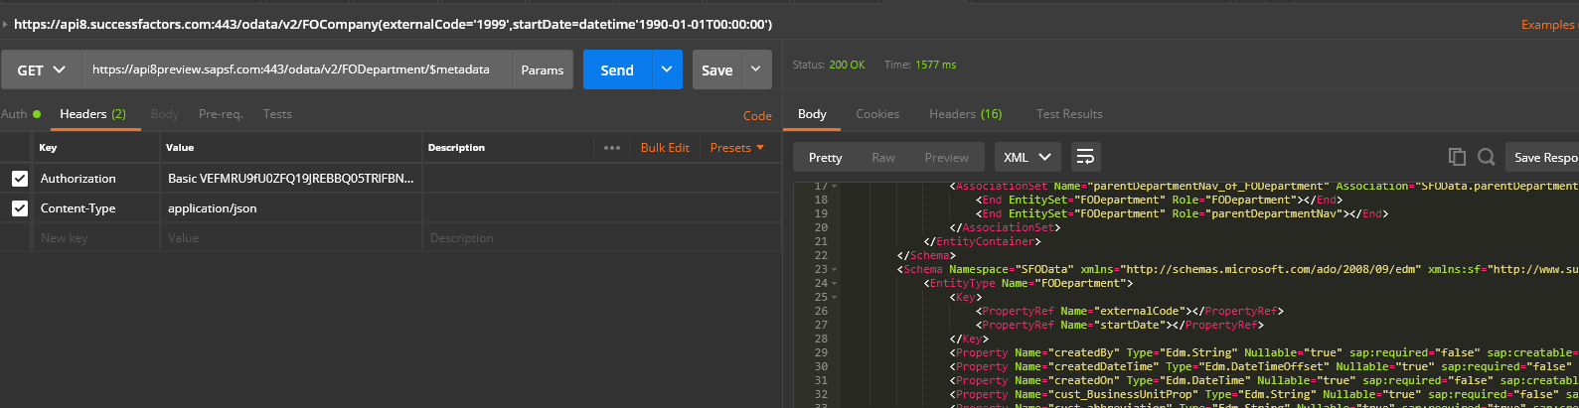
Developer Integration Tools
Postman
Is a Web REST client that allows developer and functional to monitor the HTTP request and responses.
Enables developer and functional to perform web service inspection, mock development and simulation for Odata API.
Enables developer to extend the view of the structure/metadata of SuccessFactors entities and can simulate the update or creation of record in SuccessFactors.
Copyright © 2018 Accenture. All rights reserved.
Notes:
Postman tool benefits developer, tester and functional to perform simulations for Odata API, manipulate string when updating record in SF.

Slide 30
Cloud Integration Platforms
SAP Cloud Platform
an open platform as a service (PaaS) which provides customers and partners with in-memory capabilities, core platform services, and unique business services for building and extending personalized, collaborative, and mobile-enabled cloud applications.
It delivers out-of-the-box integration between cloud application, other cloud and on-premise applications, both from SAP and non-SAP.
Dell Boomi
A multi-purpose PaaS for Atom Sphere Integration Platform as a Service (iPaaS), Master Data Management (MDM) and API Management
Enables customers to integrate any combination of cloud and on-premises applications.
Copyright © 2018 Accenture. All rights reserved.
Notes:
For more complex integrations where custom logic is needed to update data within SAP SuccessFactors or trigger actions in real time, then an implementation platform such as HCI or Boomi is the best choice.
An integration platform can also be used for automating and compressing a business process.
For example, when hiring candidates using the Recruiting module, reducing the time it takes to complete the process lowers costs and risk.
This capability is also known as auto progression, and is essentially a workflow that automatically routes candidates through the recruiting process based on certain triggers or outcomes.
Another benefit of using an integration platform is being able to extend the system’s capabilities.
By building a seamless integration with other vendors, you can offer a service that is not natively available in your SAP SuccessFactors solution.
This includes benefits, payroll, background verifications, and assessments.
The objective is to summarize all the results and display them in one system so the user only has to go into that single system to complete an action.
From a user perspective, even if there are two different systems and vendors, it will appear as a single integrated solution.
An integration platform makes it easy to integrate with other cloud based systems.

Slide 31

Question and Answer
Copyright © 2018 Accenture. All rights reserved.

Slide 32
Thank You!
Copyright © 2018 Accenture. All rights reserved.

